Slide 1
Eco Drive
PIP2001 Capstone Project
Review-0
Batch Number:CSG-G07
Roll Number | Student Name
20211CSG0026 | Gnanavika M
20211CSG0005 | Shreyas DM
20211CSG0029 | Mohammed Abdul Umar
20211CSG0035 | R Kamal Raj
Under the Supervision of,
Dr.Yamanappa
Assistant Professor
School of Computer Science and Engineering
Presidency University
Name of the Program:Computer Science And Technology
Name of the HoD: Dr,Saira Bhanu Atham
Name of the Program Project Coordinator: Dr.Yamanappa
Name of the School Project Coordinators: Dr. Sampath A K / Dr. Abdul Khadar A / Mr. Md Ziaur Rahman

Slide 2
Content
Problem Statement
Github Link
Analysis of Problem Statement
Timeline of the Project
References

Slide 3
Problem Statement Number:
Organization: Samsung R&D
Category (Hardware / Software / Both) :Software
Problem Description:Eco Drive Goal: Reduce carbon footprint of the travel Proposal: Build a smartphone app that helps you to car/bike pool, compare and compete with your friends on the carbon footprint of the travel. Air pollution in India is a serious issue with major contributors being vehicle emissions and traffic congestions. Individuals and communities can play a more effective role in reducing the air pollution if they are aware of their contributions to the same. Carbon footprint is one way of quantifying the direct and indirect emissions. We propose smartphone application (app) that can automatically track the carbon footprint of the users by analysing the details of the commute, such as mode of travel, distance, and duration. Basic guidelines of the app: 1. Community centred – the app lets you invite family and friends to join a community that strives to reduce the carbon footprint 2. Gamification – Virtual points/badges awarded to the members who top the eco-friendliness of commute, or make significant improvements to their carbon footprint 3. Simple to use – the app may request the user to setup their regular mode of travel (private vehicle or public transport) during the onboarding time. The app infers other details of the commute automatically through smartphone sensors (GPS etc.) and related framework, for e.g., Android’s DetectedActivity class
Difficulty Level: Complex

Slide 4
Github Link
The Github link provided should have public access permission.
Github Link
https://github.com/ECODR1VE/PPT

Slide 5
Analysis of Problem Statement
Technology Stack Components:
1.Frontend:
Language: React Native or Flutter for cross-platform compatibility.
UI Framework: Material Design or Cupertino for a native-like experience.
State Management: Redux or Zustand for managing application state.
2.Backend:
Language: Python (Django or Flask) or Node.js (Express) for server-side logic.
Database: PostgreSQL or MongoDB for storing user data, community information.
Cloud Platform: AWS, GCP, or Azure for hosting the backend and scaling as needed.
3.Mobile Sensors:
GPS: For determining location and distance traveled.
Accelerometer: For detecting vehicle movement and speed.
Gyroscope: For determining vehicle orientation and direction.

Slide 6
Analysis of Problem Statement
Software and Hardware Components:
1.Software:
Mobile App: Developed using the chosen frontend framework.
Backend Server: Deployed on a cloud platform.
Carbon Footprint Calculation Library: A library or algorithm to calculate carbon emissions data.
Mapping API: Google Maps or OpenStreetMap for visualizing routes and locations.
Gamification Engine: A system to manage virtual points, badges, and leaderboards.
2.Hardware:
Smartphones: Devices running iOS or Android.
Servers: Machines running the backend software.
Network Infrastructure: Connectivity for data transfer between devices and servers.

Slide 7
Analysis of Problem Statement (contd...)
The proposed app offers a promising approach to reducing carbon footprints by:
Promoting carpooling: Encouraging users to share rides and reduce the number of vehicles on the road.
Raising awareness: Providing users with information about their carbon footprint and comparing it to others.
Gamification: Motivating users to adopt sustainable behaviors through rewards and competition.
Ease of use: Automating data collection and providing a user-friendly interface.

Slide 8
Analysis of Problem Statement (contd...)
Some potential challenges and considerations include:
Data privacy: Ensuring the secure handling of user data, especially location information.
Accuracy of carbon footprint calculations: The accuracy of calculations depends on the quality of data collected from mobile sensors.
User adoption: The app's success will depend on its ability to attract and retain users.
Integration with other transportation services: Integrating with public transportation systems or ride-sharing platforms could enhance its utility.

Slide 9
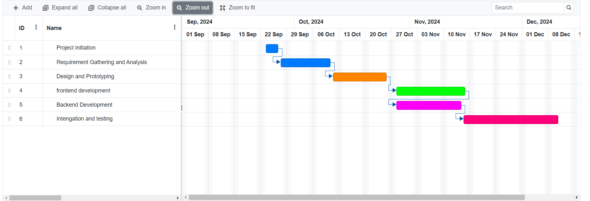
Timeline of the Project (Gantt Chart)

Slide 10
References (IEEE Paper format)
1.Academic Databases
Google Scholar: https://scholar.google.com/
JSTOR: https://www.jstor.org/
IEEE Xplore: https://ieeexplore.ieee.org/Xplore/home.jsp
2.Tech News and Blogs
TechCrunch: https://techcrunch.com/
VentureBeat: https://venturebeat.com/
The Verge: https://www.theverge.com/
3.Government Reports and Statistics
United Nations Environment Programme (UNEP): https://www.unep.org/
Intergovernmental Panel on Climate Change (IPCC):
https://www.ipcc.ch/
Indian Government Websites: https://www.india.gov.in/

Slide 11


